Slide 1

The Finale Challenge
Charu Talreja

Slide 2
Introduction
As the need of documentation is increasing day by day, so is the task of maintaining documentation is becoming tedious. The larger the organization, the better document processing is required.
In industries like Health, Banking and Finance the huge usage of paper documents has pushed business to think and work upon a better and feasible automated document analysis pipeline.
Each year organizations dedicate a significant amount of time and resources to process the documents (physical or electronic).
Much of this requires employees to manually churn through documents, extracting information and keying into their enterprise applications.
This is slow and error-prone, which leads to cost, control, and quality issues as well as worker dissatisfaction.

Slide 3
Technology – AWS Services
AWS S3
Amazon Lambda
Amazon Textract
Amazon Comprehend
Amazon A2I
Amazon Cloud Watch logs
IAM roles, users, Groups
SNS Notifications

Slide 4
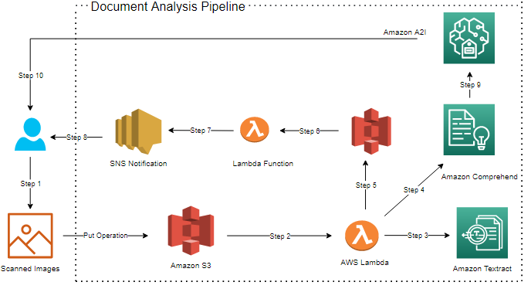
Solution Architecture
Building an end-to-end intelligent document processing solution using AWS

Slide 5
Solution Architecture - Explanation
Step 1 - The end user will upload a scanned image of the document in S3 bucket.
Step 2 – Put operation in S3 bucket [extractdatafrompdf] will trigger the lambda function [getTextPDFFromS3]
Step 3 - The code in lambda function uses a function to call Amazon Textract DetectDocumentText API and extracts the data.
Step 4 – The same code will further call Amazon Comprehend key phrases, entities and sentiment functions.
Step 5 –Finally the lambda code will send the output in json format to an S3 bucket[extracteddata-s3].
6 – Further, when this json file is uploaded in S3 bucket , second lambda function [MonitoringLambdaFn] will trigger.
7 – The destination of above lambda is stored as an SNS notification, the final output and success message will be sent using SNS.
8 – The results are received using SNS to the user’s email.
9 – The comprehend will be connected to A2I, when lambda gets triggered the analysis jobs in comprehend will be in progress.
10 –Further, when its completed, the A2I worker portal will show a new job. The team can finally start doing the process and complete the review.

Slide 6
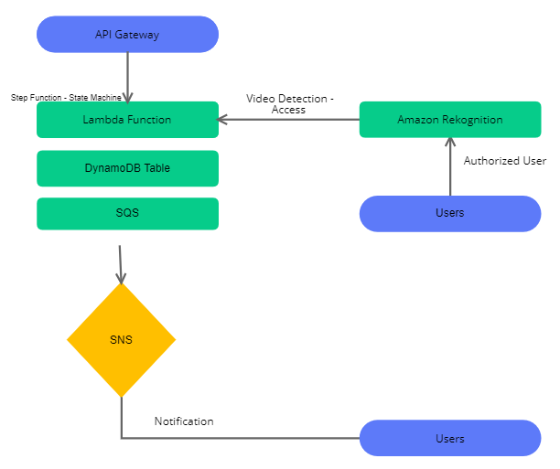
Workflow – Challenge 2
Building a secure data collection and data access system to be used by employee of an organization.

Slide 7
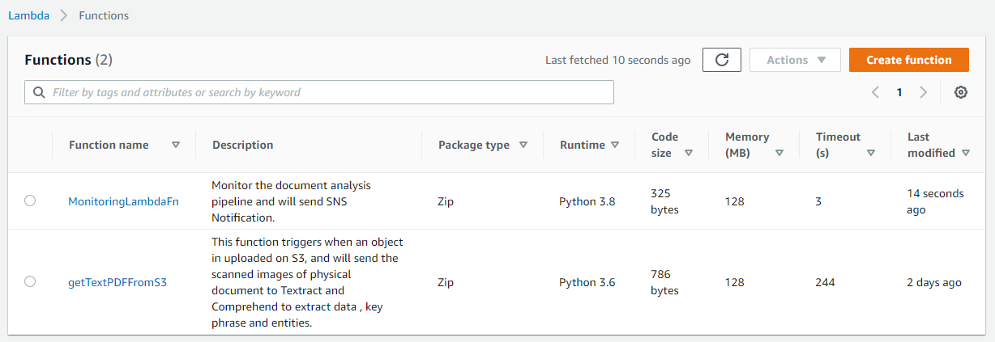
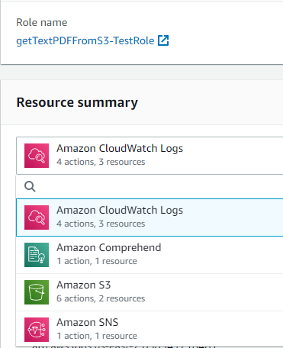
Prototype Screenshots
Lambda Functions -

Slide 8
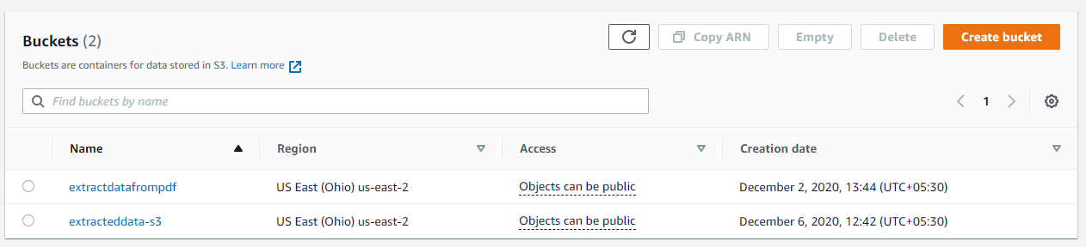
Prototype Screenshots
S3 Buckets -

Slide 9
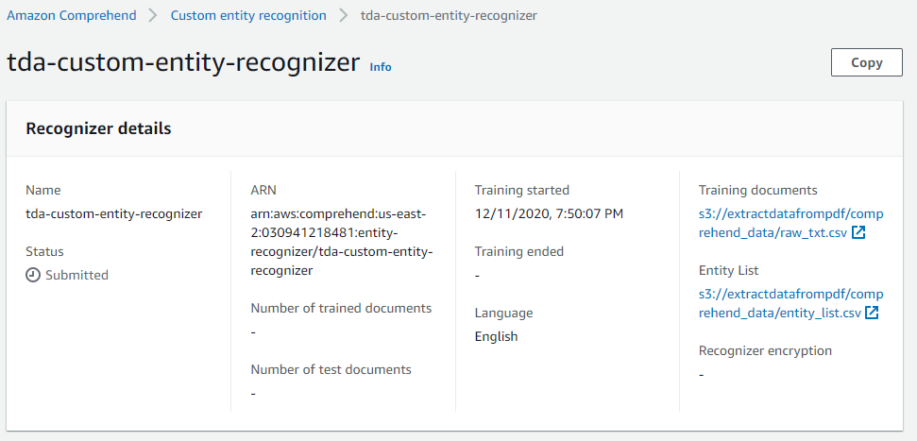
Prototype Screenshots
Amazon Comprehend – Custom Entity Recognition.

Slide 10
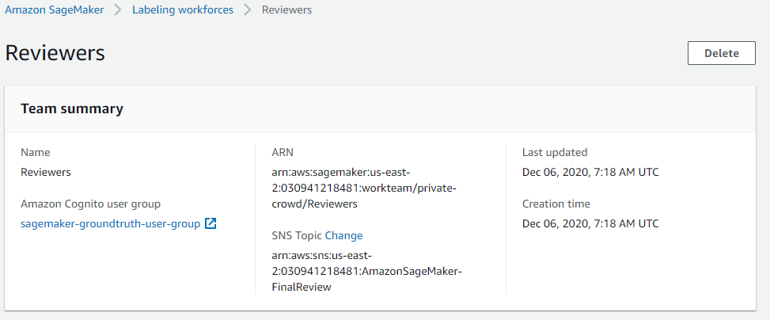
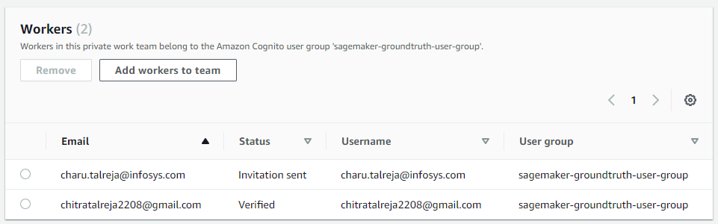
Prototype Screenshots
Amazon A2I Workforce

Slide 11
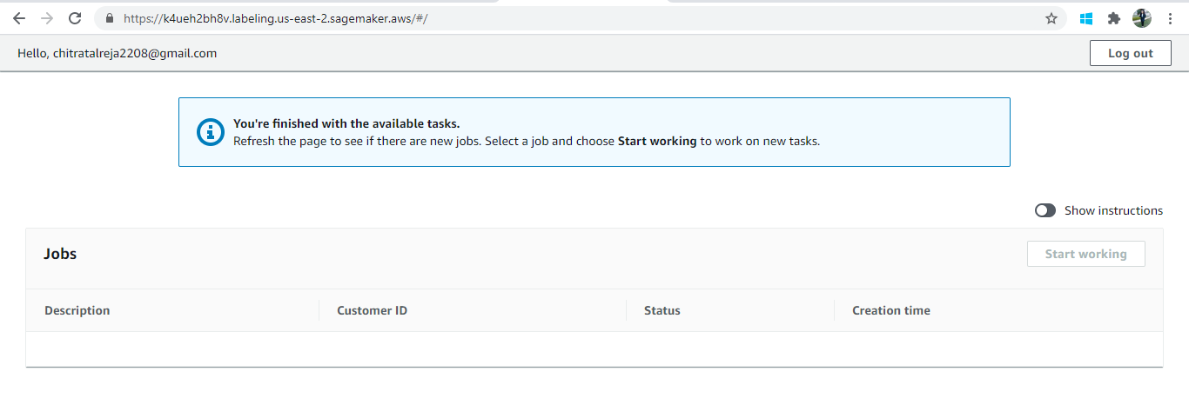
Prototype Screenshots
Amazon A2I Workers Dashboard

Slide 12
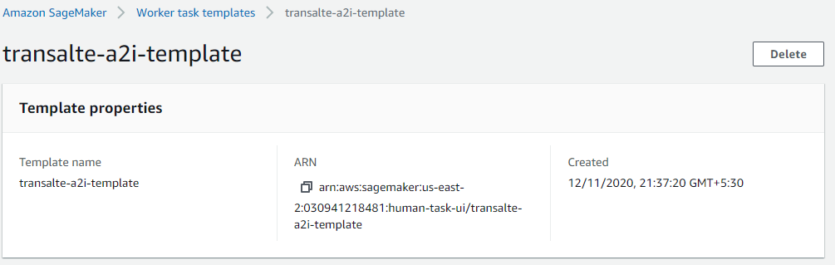
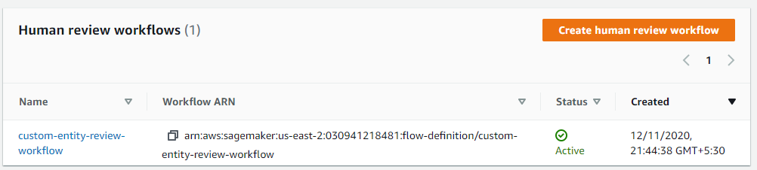
Prototype Screenshots
A2I – Worker Task Template.
Human Review Workflow.

Slide 13
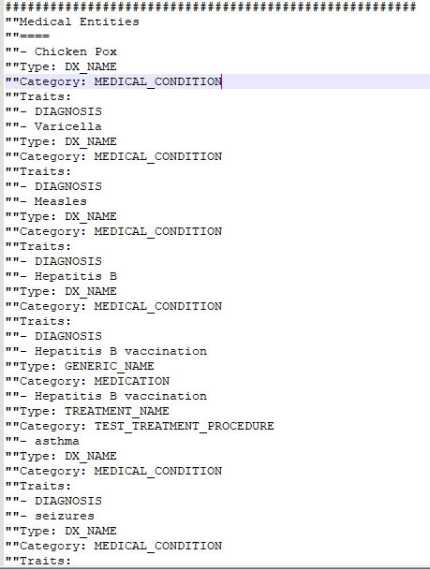
Prototype Screenshots
Example Output.

Slide 14
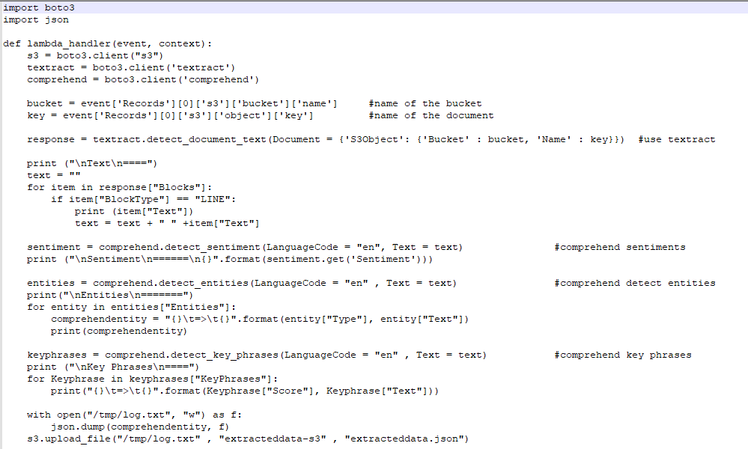
Lambda Code -

Slide 15
Future enhancements
1
Document Analysis Pipeline – Usage in Health Care
The proposed idea can be easily used in health care centers, the only change will be done in lambda code. Instead of using comprehend we can use medical comprehend.
Data Storage
2
We can store the data in RDS or DynamoDB, which is being reviewed using A2I, for future use.
For example: Health care centers save patients medical history so that for future treatments they have complete record of patient.

Slide 16
Thank You

